Slide 1

Using a mask is important
Haegang Yang

Slide 2
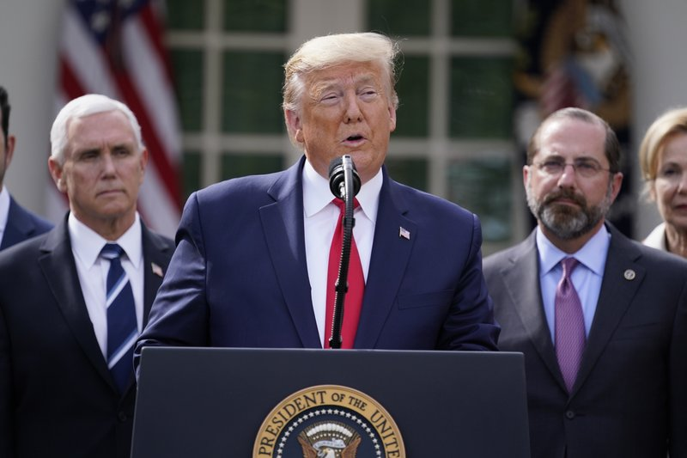

Slide 3
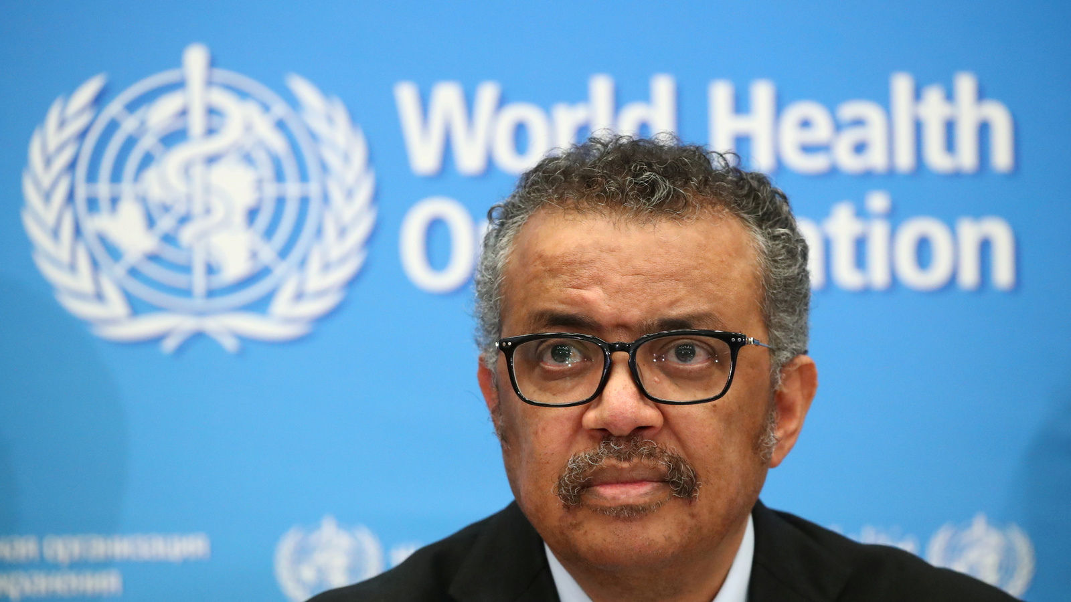

Slide 5
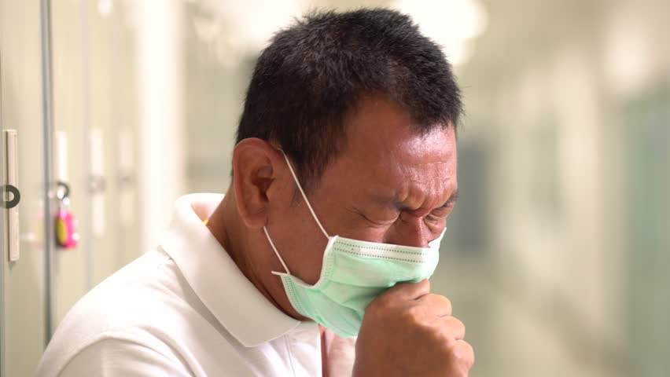

Slide 7
